Slide 1
Project Update 3
Alec Schneider

Slide 2
Overall Summary
Accomplishments This Past Period:
One hot encoded other categorical variables to use in modeling
Created Xgboost models to extract important features from the dataset
Used the important features to create linear regression, svm, and naïve bayes models
Created function that trains a model on the training data, predicts on the test data, and scores the model
Next Steps:
Write up answers to the business questions that were asked in update 1
Select the final model to predict the Satisfaction variable
What’s working well:
Xgboost model training speed and highlighting of important variables
Plotting of predictions and whether the prediction was correct or incorrect
Saving all the trained models to a folder to be able to be loaded into R later
Issues:
Model training time - svm models taking hours to train have inhibited progress and iterations

Slide 3
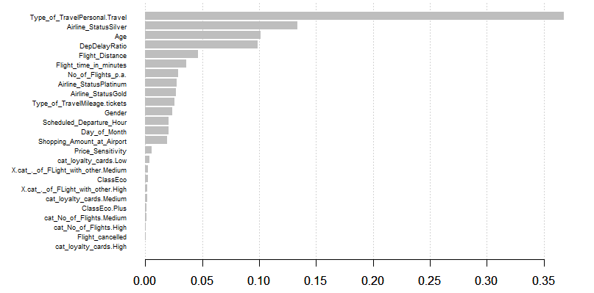
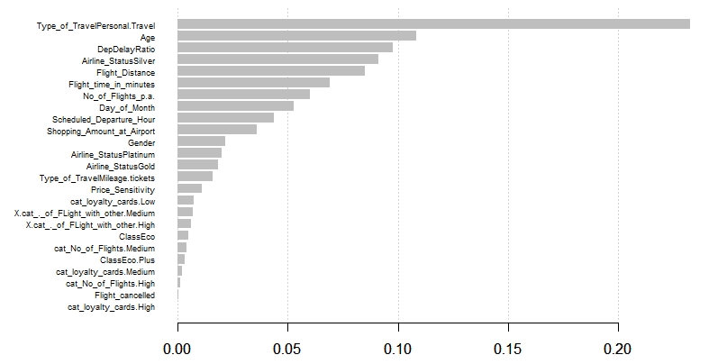
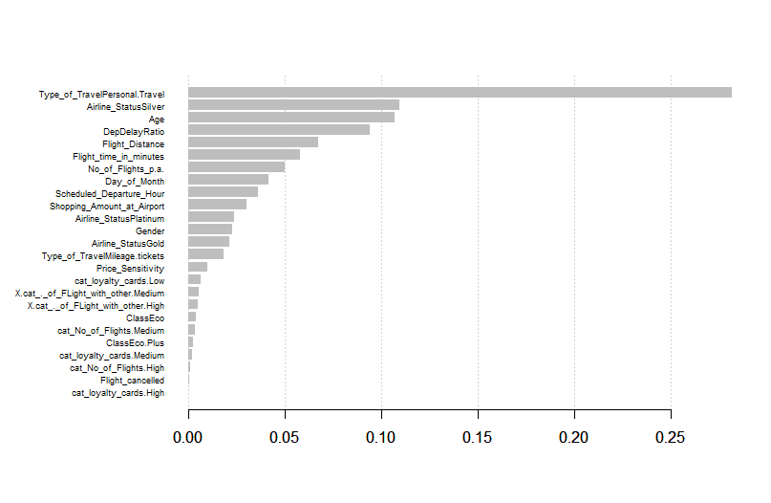
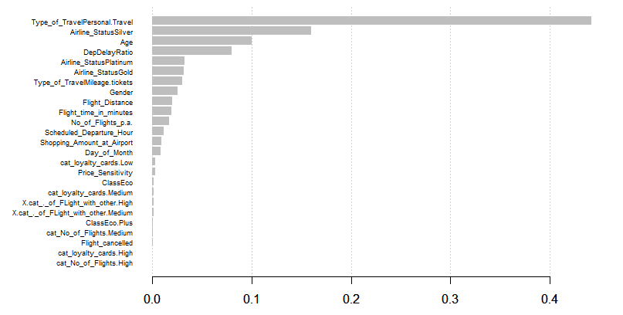
Important Features - Xgboost

Slide 4
Important Features - Xgboost
Top Feature across models:
Type_of_TravelPersonal.Travel – by far the most important feature across all models
Airline_StatusSilver
Age
DepDelayRatio
Flight_Distance
Flight_time_in_minutes
Gender
Airline_StatusPlatinum
Scheduled_Departure_Hour
Shopping_Amount_at_Airport
Airline_StatusGold
Price Sensitivity
Day_of_Month
Type_of_TravelMileage.Tickets

Slide 5
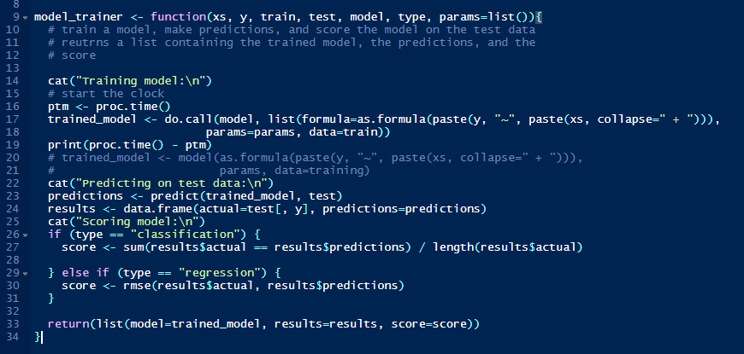
Model_trainer function

Slide 6
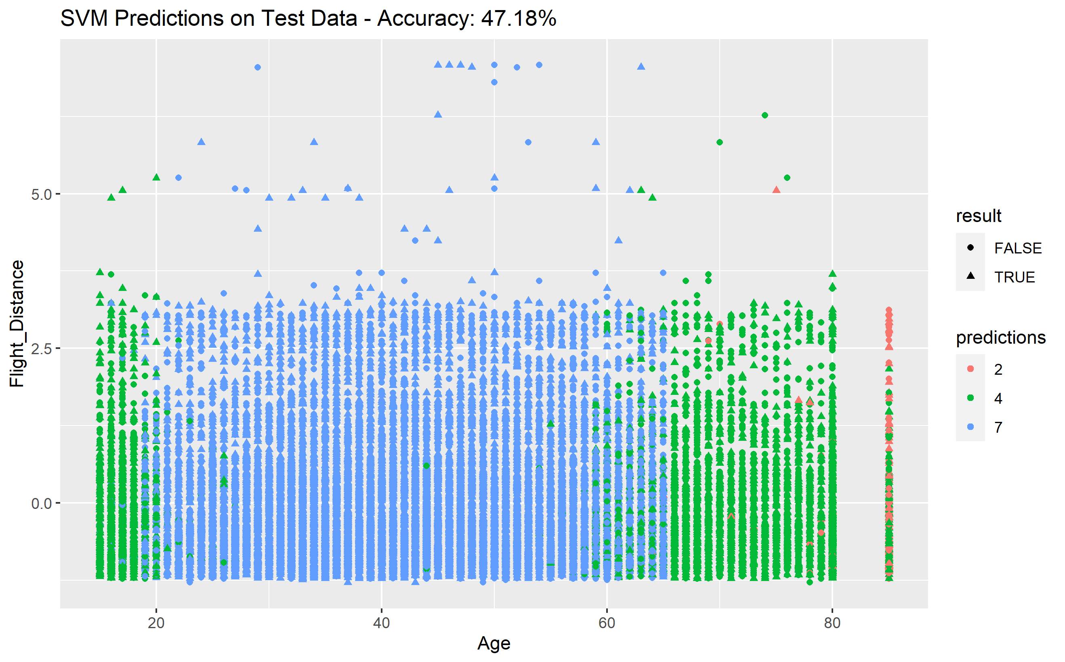
Support Vector Machine Predictions

Slide 7
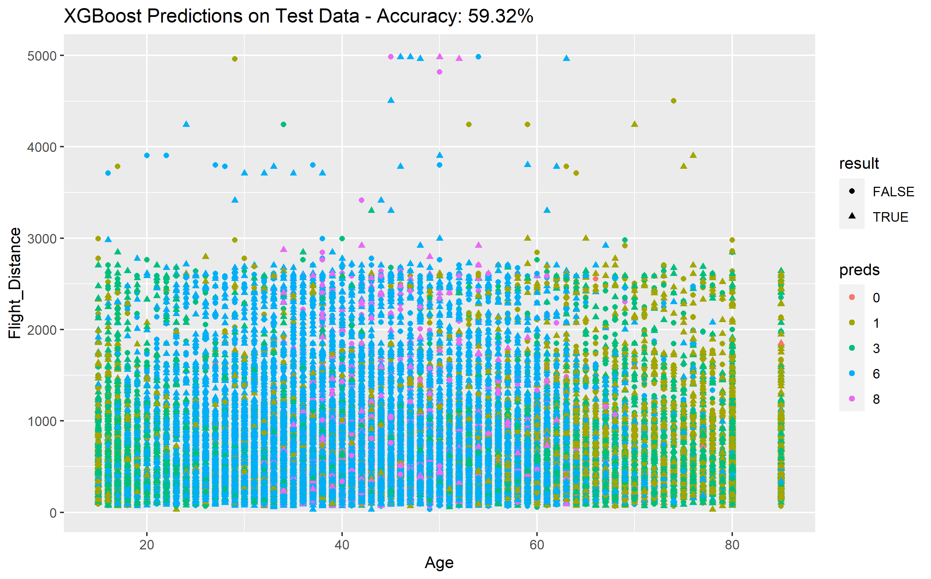
Extreme Gradient Boosting Predictions

Slide 8
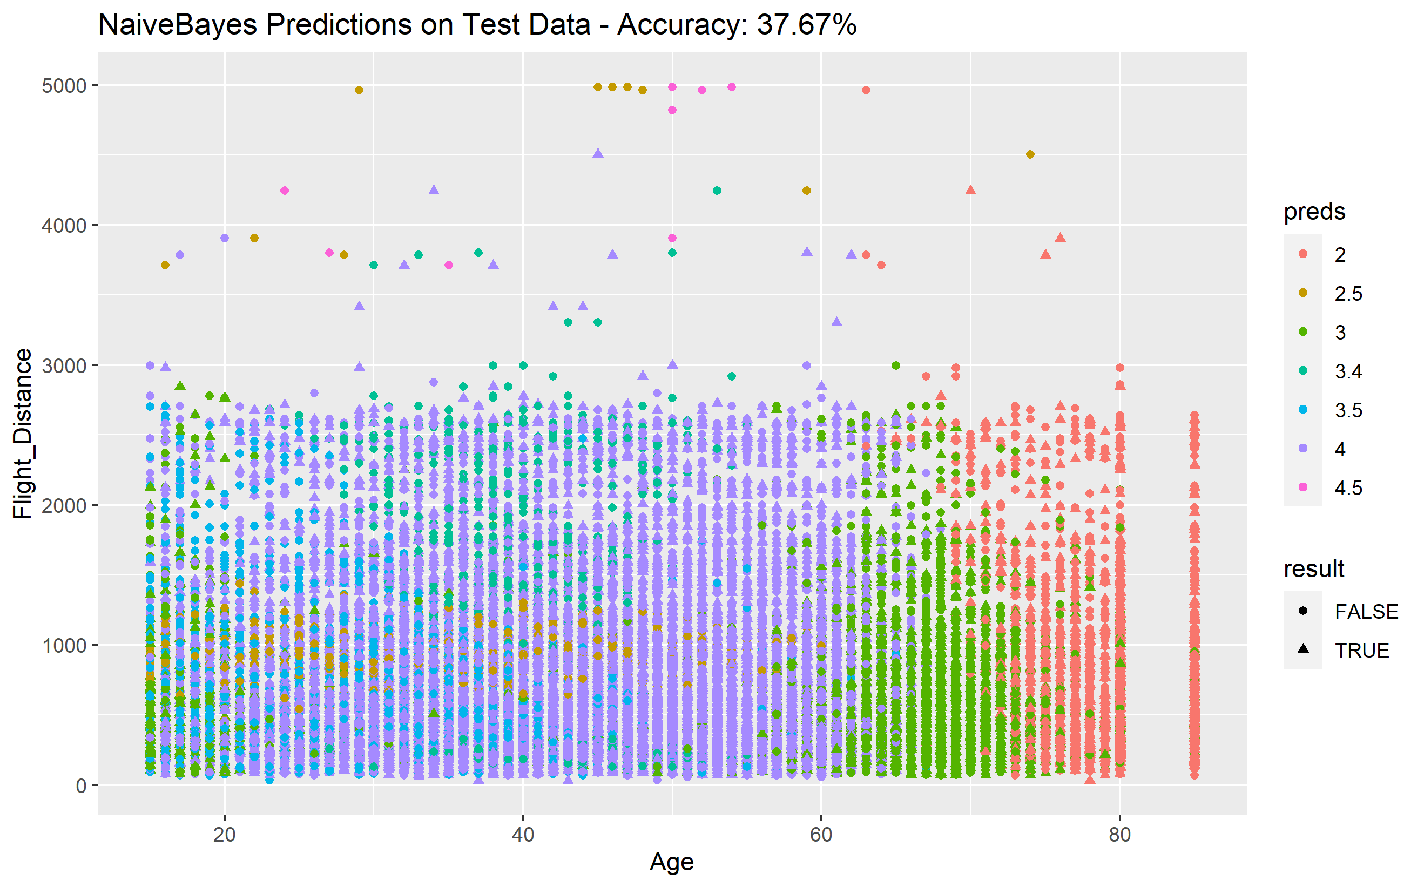
Naïve Bayes Predictions

